Slide 1
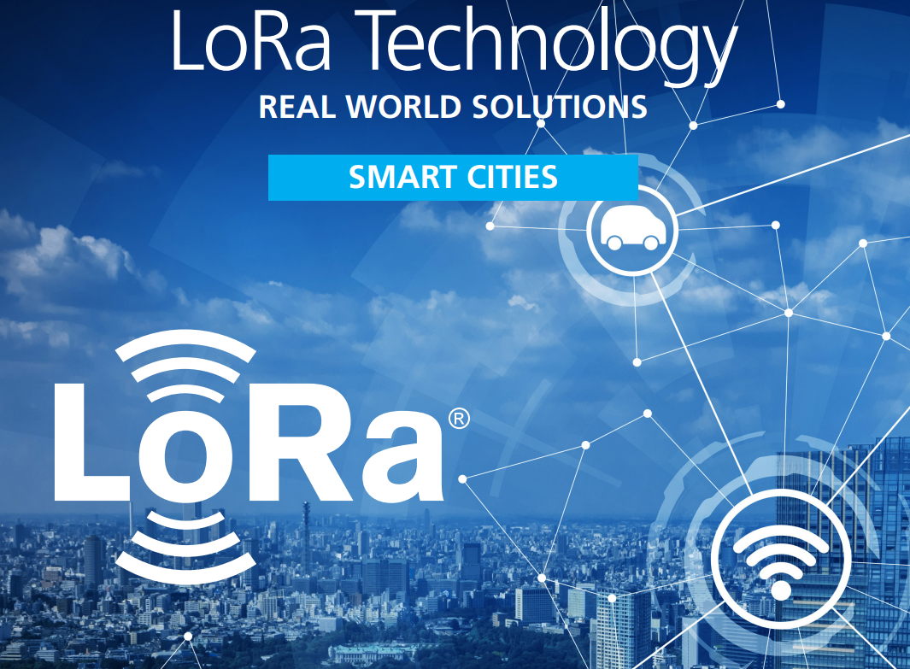
Integrating LoRaWAN
and
Geospatial Technologies
for
Next-Generation Smart Cities
Presented by:
Dr M Brindha
Associate Professor
CSE Department
NIT - Trichy
Dr Sekar C
Assistant Professor
School of Computing
SRMIST - Trichy

Slide 2
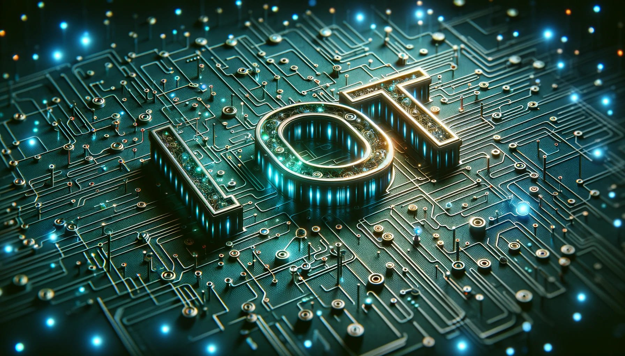
Introduction to IoT

Slide 3
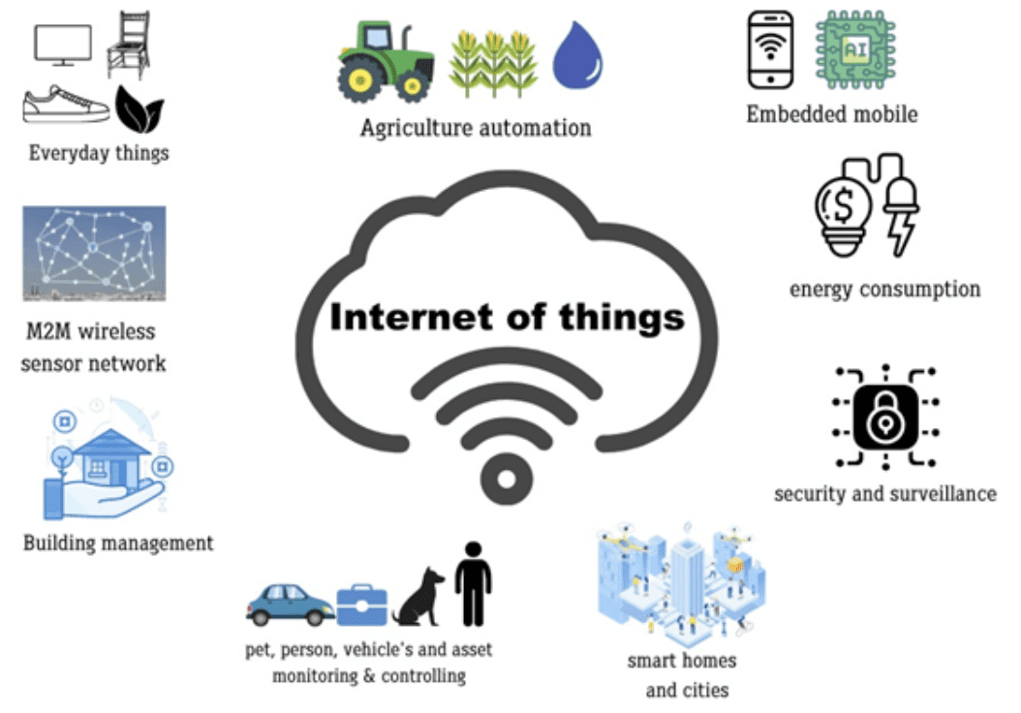
What is IoT?
“The Internet of Things is the network of physical objects that contain embedded technology to communicate and sense or interact with their internal states or the external environment.” Gartner

Slide 4
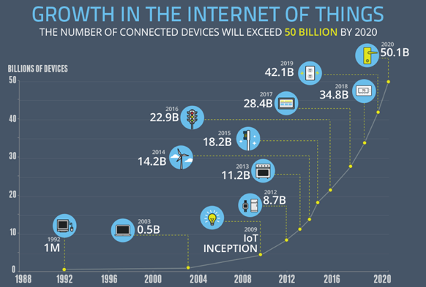

Slide 5





















IOT MARKET FORECAST
50 Billion
USD 7 Trillion (CAGR: 21%)
50 Billion
USD 1.6 Trillion (CAGR: 13%)
32 Billion
USD 1 Trillion (CAGR: 33%)
28 Billion
28 Billion
28 Billion
18 Billion
“IoT will result in $1.9 trillion in global
economic value-add in 2020” [2013]

Slide 6
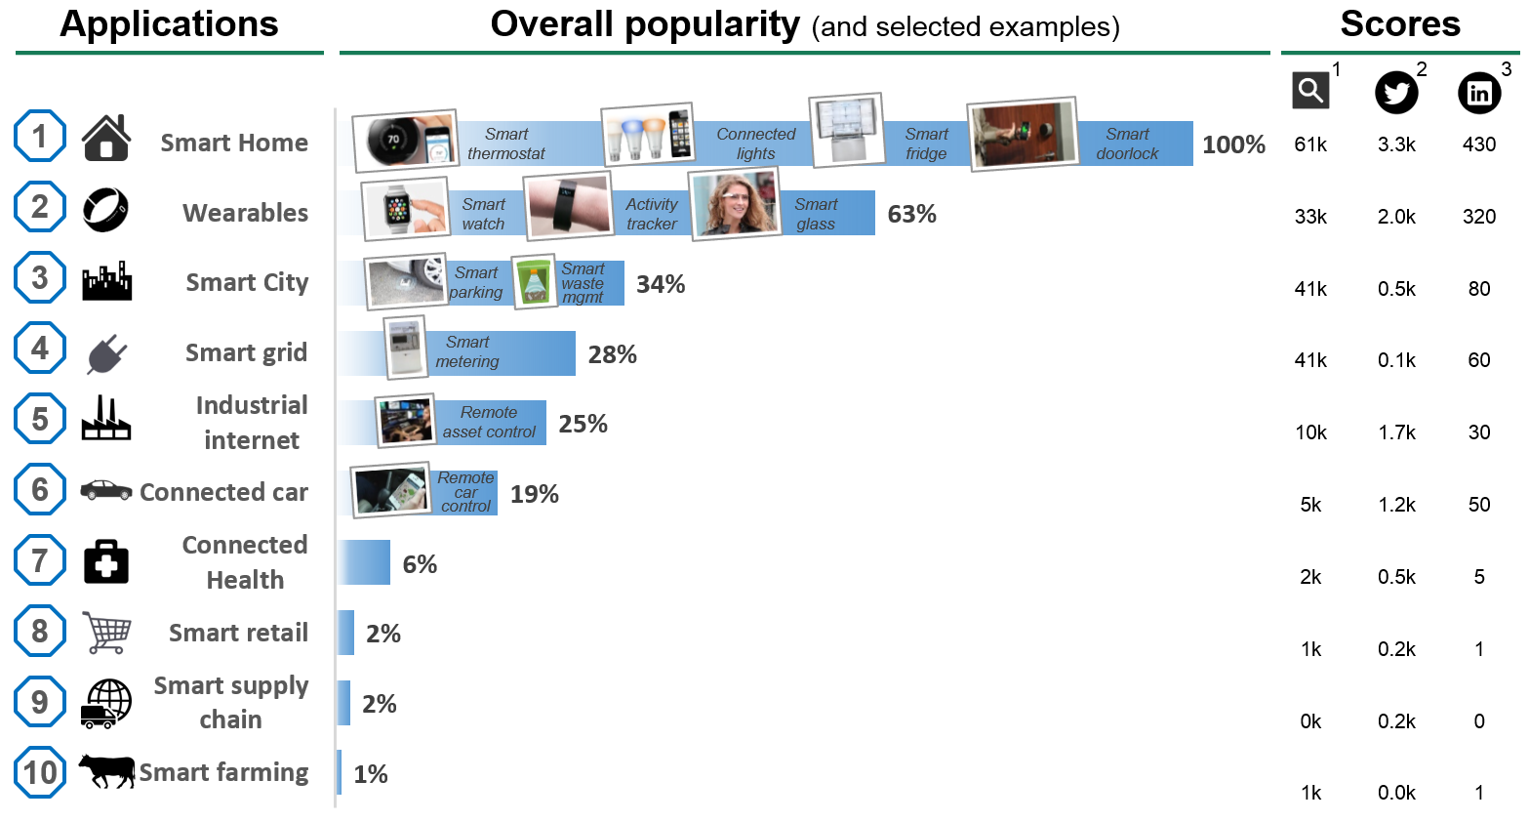
IOT CURRENT APPLICATIONS

Slide 7
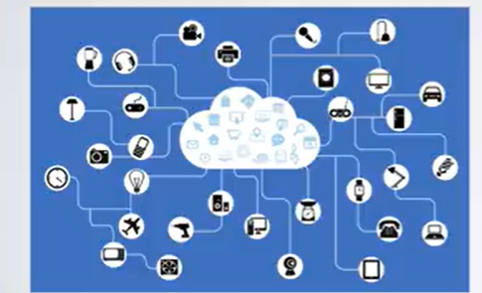
Wireless Technologies
There are many wireless technologies used to connect these devices to the internet
Short range wireless communication
Cellular Communication
LPWAN Communication

Slide 8
What is LoRa?
PHY Radio Protocol for the Internet of Things
Derivative of Chirp Spread Spectrum
Proprietary to Semtech
Designed for long range, low power; low data rate
Star topology (not mesh or p2p)
Bits to kilobits per second
(depending on channel width & modulation)

Slide 9
What is LoRaWAN?
Wireless Network for the Internet of Things
Open, non-proprietary standard
Adds addressing, mobility & localisation
Multiple base stations can receive & process packets
Adaptive data rate scheme to improve performance
Multiple levels of encryption (Network & Application)
Supports time slot scheduling of device transmission

Slide 10
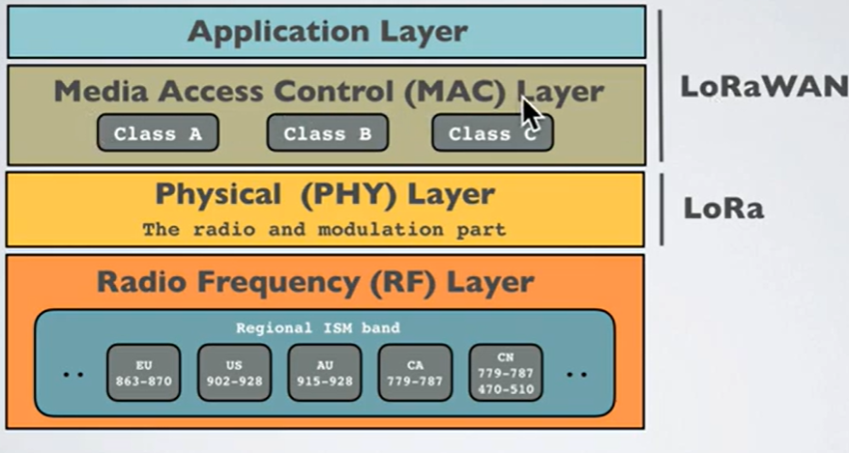
LoRa Protocol Stack

Slide 11
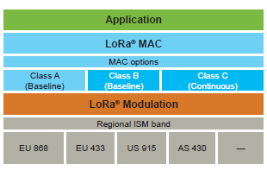
LoRaWAN
LoRaWAN™ defines the communication protocol and system architecture for the network while the LoRa® physical layer enables the long-range communication link.
The protocol and network architecture have the most influence in determining the battery lifetime of a node, the network capacity, the quality of service, the security, and the variety of applications served by the network.

Slide 12
What is LoRaWAN?
LoRaWAN (Long Range Wide Area Network) is a low-power, long-range wireless technology designed for IoT applications.
Derived from Chirp Spread Spectrum (CSS) technology. It encodes information on radio waves using chirp pulses - similar to the way dolphins and bats communicate!
LoRa modulated transmission is robust against disturbances and can be received across Long distances.
Image source : the things network

Slide 13
What is LoRaWAN?
LoRa is ideal for applications that transmit small chunks of data with low bit rates.
Data can be transmitted at a longer range compared to technologies like WiFi, Bluetooth or ZigBee.
These features make LoRa well suited for sensors and actuators that operate in low power mode.
LoRa can be operated on the license free sub-gigahertz bands, for example, 915 MHz, 868 MHz, and 433 MHz.
It also can be operated on 2.4 GHz to achieve higher data rates compared to sub-gigahertz bands, at the cost of range.
These frequencies fall into ISM bands that are reserved internationally for industrial, scientific, and medical purposes

Slide 14
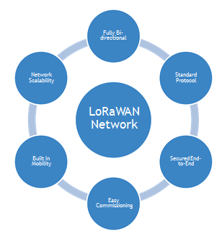
Fully Bi- directional
Lorawan Network
Network
Scalability
Standard
Protocol
LoRaWAN
Network
Built In Mobility
Secured End- to-End
Easy Commissioning

Slide 15
Where Lora Lies
10000
LPWAN
5000
WiMAX
5G
2000
2G
3G
4G
300
Zigbee
Wi-Fi 11a/b/g/n
Wi-Fi
11ac
RFID
100
NFC
Data Rate (Mbps)

Slide 16
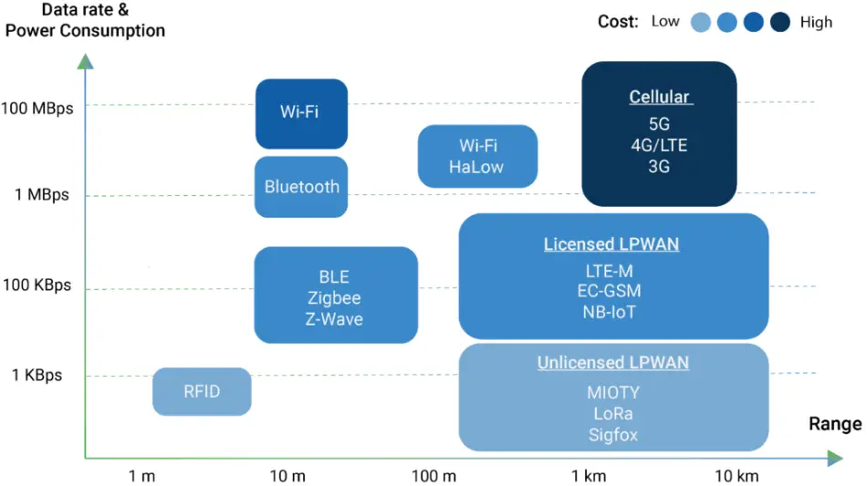
Where Lora Lies

Slide 17
The most critical factors in a LPWAN are:
Network architecture
Communication range
Battery lifetime or low power
Robustness to interference
Network capacity (maximum number of nodes in a network)
Network security
One-way vs two-way communication
Variety of applications served

Slide 18
LoRaWAN Features
LoRaWAN is a Media Access Control (MAC) layer protocol built on top of LoRa modulation.
Ultra low power - can last up to 10 years on a single coin cell battery.
Long range - can transmit and receive signals over a distance of over 10 kilometers in rural and up to 3 kilometers in dense urban areas.
Deep indoor penetration - deep indoor coverage, and easily cover multi floor buildings.
License free spectrum - You don’t have to pay expensive frequency spectrum license fees to deploy a LoRaWAN network.
Geolocation- can determine the location of end devices using triangulation without the need for GPS. A LoRa end device can be located if at least three gateways pick up its signal.
End-to-end security- secure communication between the end device and the application server using AES-128 encryption.
Firmware updates over the air - can remotely update firmware (applications and the LoRaWAN stack)

Slide 19
Battery Lifetime
The nodes in a LoRaWAN™ network are asynchronous and communicate when they have data ready to send whether event-driven or scheduled.
In a mesh network or with a synchronous network, such as cellular, the nodes frequently have to ‘wake up’ to synchronize with the network and check for messages.
This synchronization consumes significant energy and is the number one driver of battery lifetime reduction.
In a recent study and comparison done by GSMA of the various technologies addressing the LPWAN space, LoRaWAN™ showed a 3 to 5 times advantage compared to all other technology options.

Slide 20
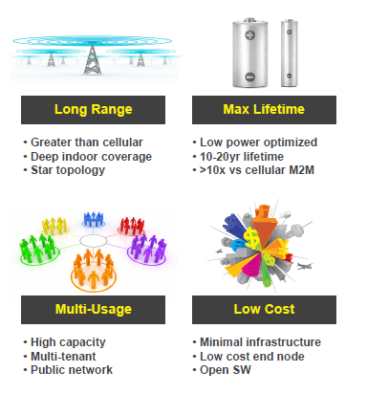

Slide 21
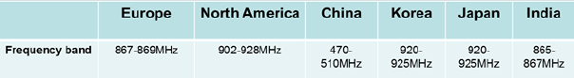
Frequency Band Of Lora Operation

Slide 22
LoRaWAN: Frequency Bands
EU 433
CN 470-510
CN 779-787
EU 863-870
IN 865-867 (NZ 865-867)
us 902-928
AS 923 (AS 923-925)
AU 915-928

Slide 23
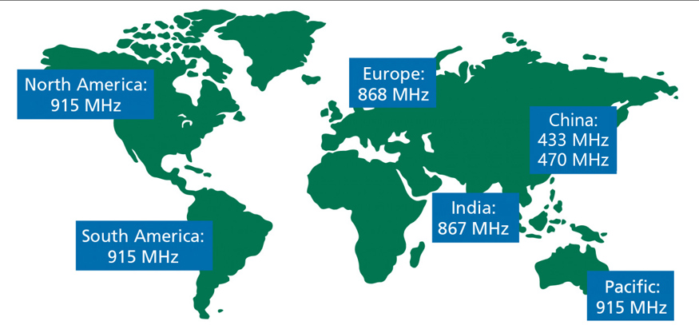
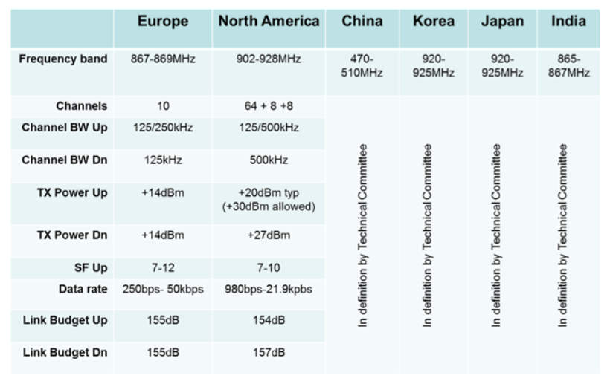
LoRaWAN Frequency
Image source : 3GLTE info

Slide 24
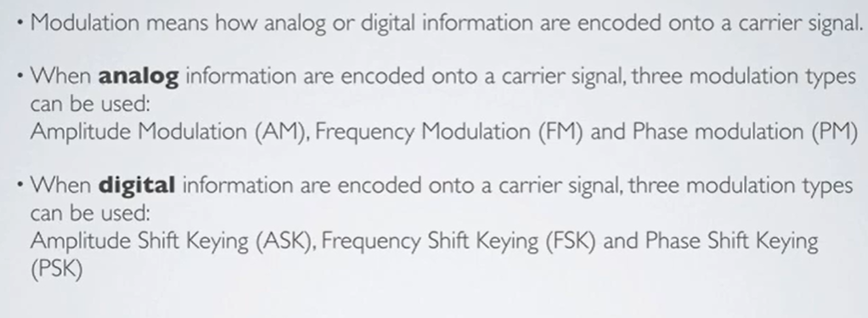
Basic Modulation types

Slide 25
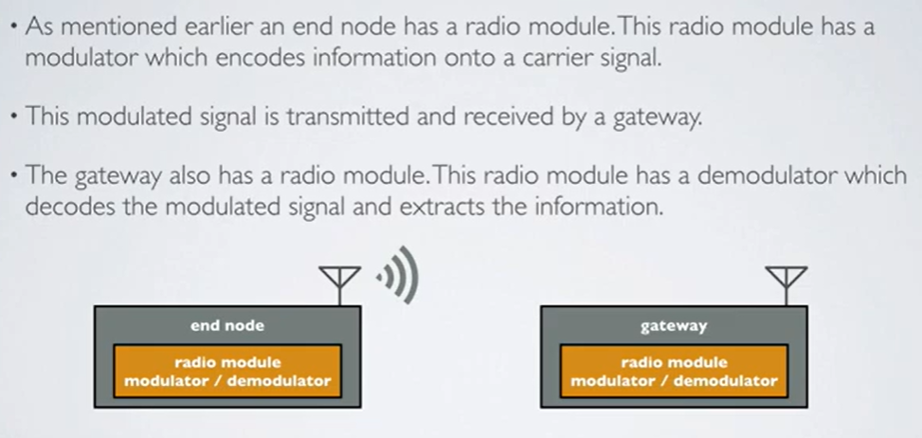
Basic Modulation types

Slide 26
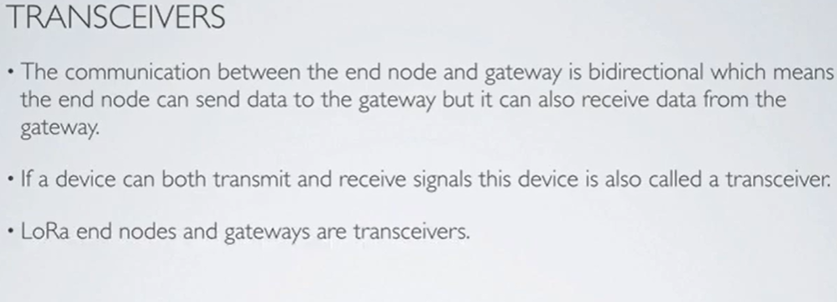
Basic Modulation types

Slide 27
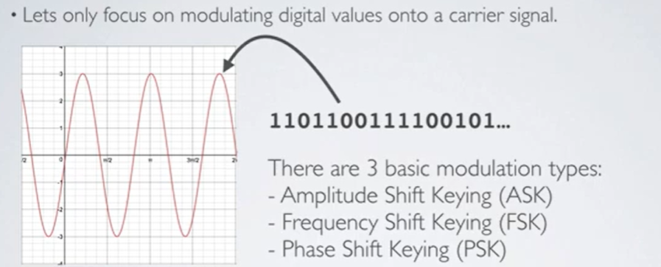
Basic Modulation types

Slide 28
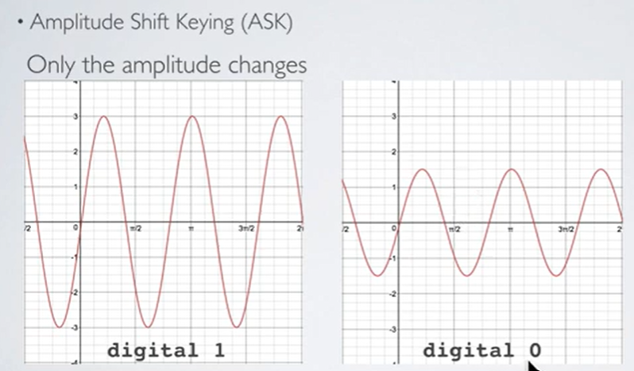
Basic Modulation types

Slide 29
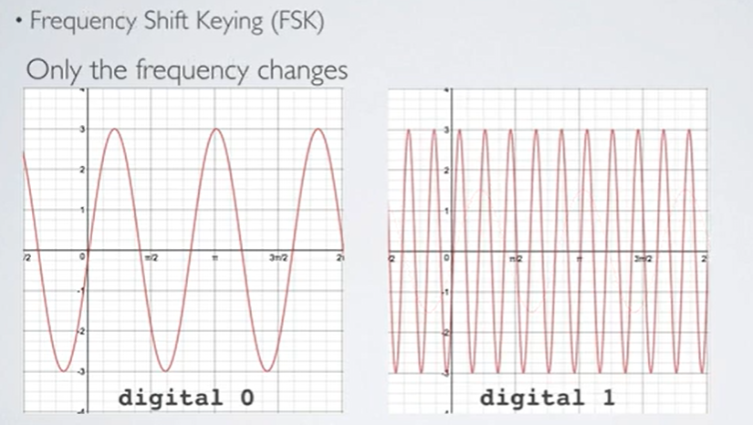
Basic Modulation types

Slide 30
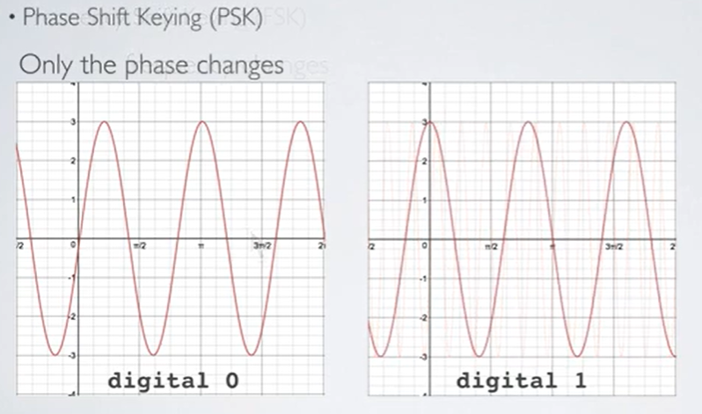
Basic Modulation types

Slide 31
CHIRP SPREAD SPECTRUM
Besides the 3 basic modulation types there are many other modulation types.
• LoRa is a proprietary spread spectrum modulation scheme that is based on Chirp Spread Spectrum modulation (CSS).
• Chirp Spread Spectrum is a spread spectrum technique that uses wideband linear frequency modulated chirp pulses to encode information.
• Spread spectrum techniques are methods by which a signal is deliberately spread in the frequency domain. For example a signal is transmitted in short bursts, "hopping' between frequencies in a pseudo random sequence.

Slide 32
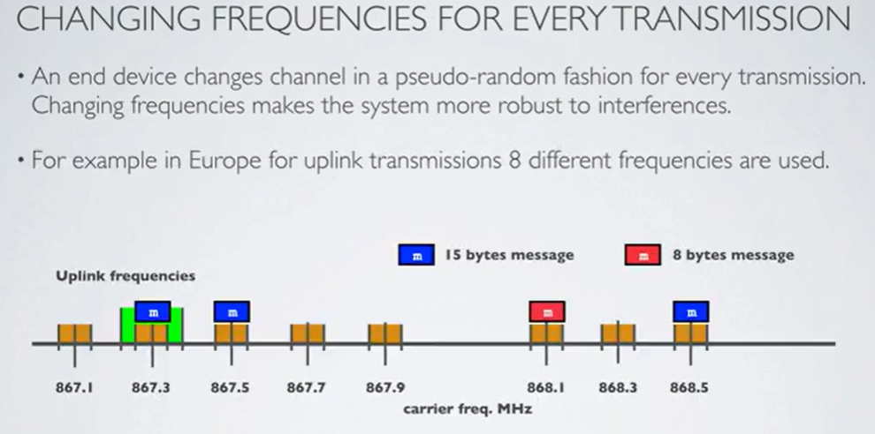
LoRaWAN Frequency
Image source : 3GLTE info

Slide 33
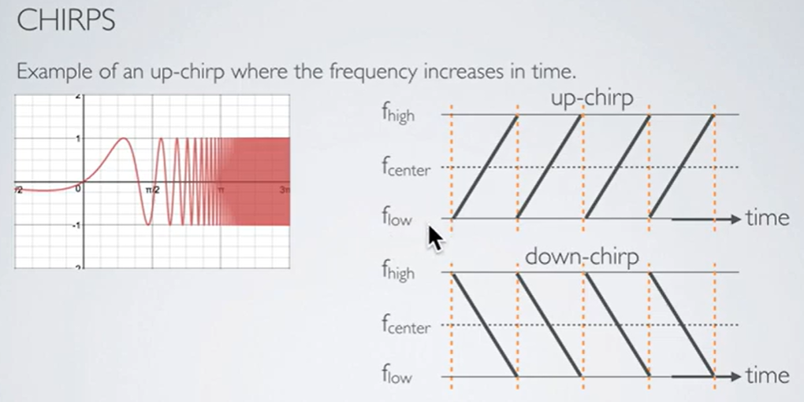
Chirps
A chirp, often called a sweep signal, is a tone in which the frequency increases (up-chirp) or decreases (down-chirp) with time.

Slide 34
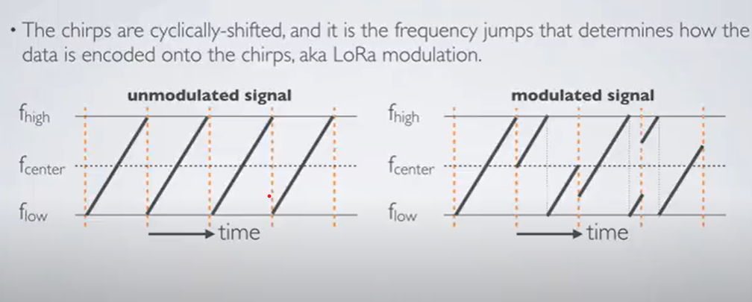
LoRA Modulation

Slide 35
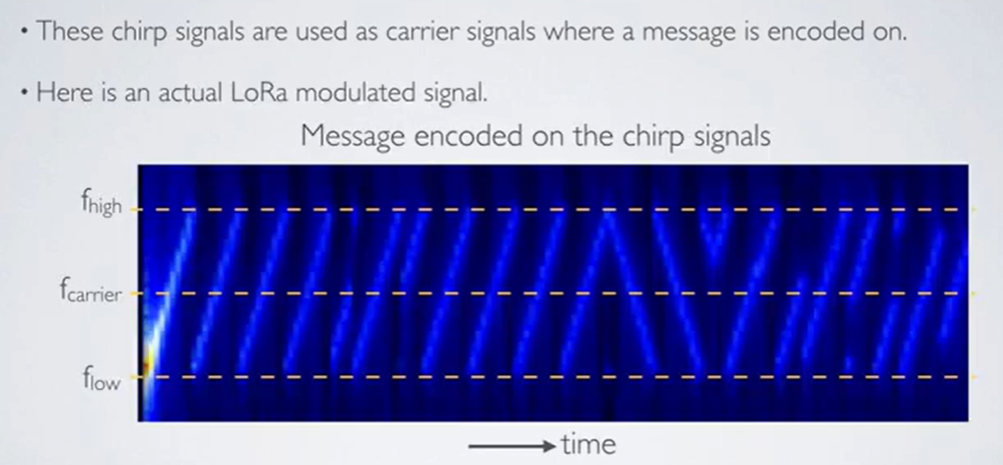
LoRA Modulated Signal
Image source : 3GLTE info

Slide 36
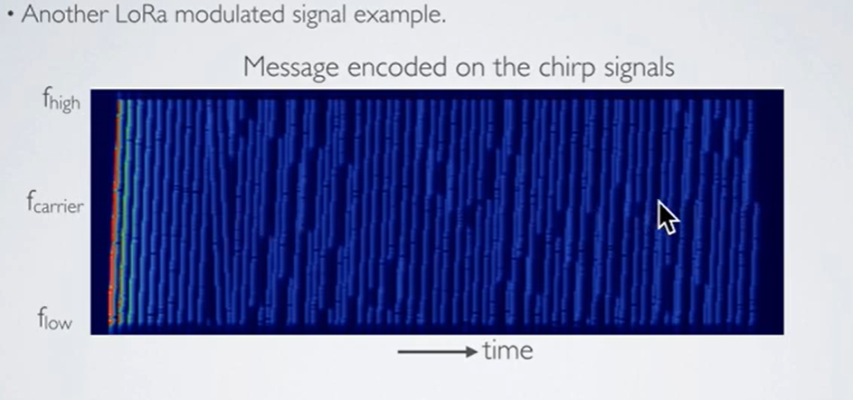
LoRA Modulated Signal
Image source : 3GLTE info

Slide 37

LoRA Modulated Signal
Image source : 3GLTE info

Slide 38
LoRaWAN: Chirp Spread Spectrum
Three Bandwidths Used:
125 KHz
250 KHz
500 KHz
Six Spreading Factors (SF) Used: SF7 - SF12
Each SF step increases air-time by twice

Slide 39
LoRaWAN Spreading Factors
LoRa Technology: Based on Chirp Spread Spectrum (CSS), where chirps (symbols) carry data.
Spreading Factor (SF):
Controls chirp rate and data transmission speed.
Lower SF = faster chirps, higher data rate, but reduced range.
Higher SF = slower chirps, lower data rate, but increased range.
Range and Data Rate: Adjusting SF balances range and data rate, impacting transmission distance and processing gain.
Congestion Control: Orthogonal SFs prevent interference on the same frequency, allowing multiple transmissions without conflict.
Spreading Factor (SF) and Bit Rate: Lower SF provides a higher bit rate at fixed bandwidth and coding rate. Example: SF7 has a higher bit rate than SF12.
Bandwidth and Bit Rate: Doubling the bandwidth doubles the bit rate for a fixed SF and coding rate.
Example Bit Rates with SF7 and CR = 1:
125 kHz: 5.5 kbit/s
250 kHz: 10.9 kbit/s
500 kHz: 21.9 kbit/s

Slide 40
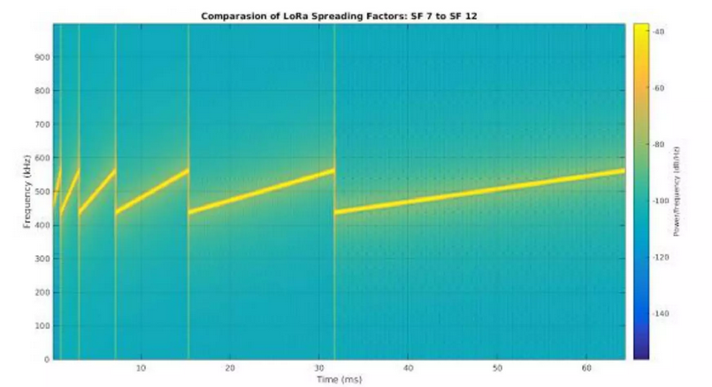
LoRaWAN: Spreading Factors

Slide 41
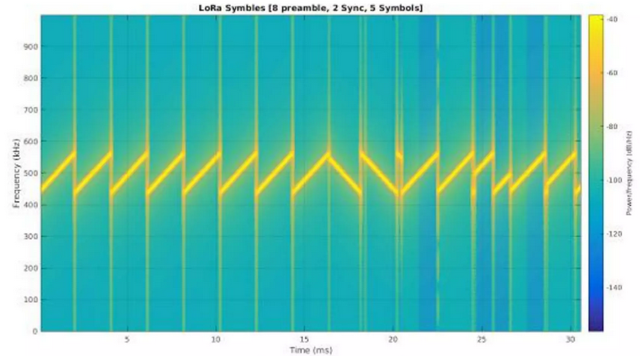
LoRaWAN: Physical Layer Message
..

Slide 42

2D simulation (flat environment)
Distance between base station and sensor
14 km
10 km
8 km 6 km 4 km 2 km
Message size of 10 bytes (payload)
1,4 sec
0,74 sec
0,37 sec
0,2 sec
530 bps
970 bps
Bitrate
290 bps
12
11
10
9
8 7 6
Spreading Factor

Slide 43
LoRaWAN: Data Rates
From Channel Bandwidth * Spreading Factor
Lowest = SF 12 * 125 KHz = 250 bps
Highest = SF 7 * 500 KHz = 21.9 kbps
EU/CN also supports FSK 50 kbps

Slide 44
Network Capacity
In order to make a long range star network viable, the gateway must have a very high capacity or capability to receive messages from a very high volume of nodes.
The critical factors effecting capacity are the number of concurrent channels, data rate (time on air), the payload length, and how often nodes transmit.
Since LoRa® is a spread spectrum-based modulation, the signals are practically orthogonal to each other when different spreading factors are utilized.
As the spreading factor changes, the effective data rate also changes.
By shifting the data rate higher, the time on air is shortened opening up more potential space for other nodes to transmit.
Adaptive data rate also optimizes the battery lifetime of a node.
In order to make adaptive data rate work, symmetrical up link and down link is required with sufficient downlink capacity.
These features enable a LoRaWAN™ network to have a very high capacity and make the network scalable.

Slide 45
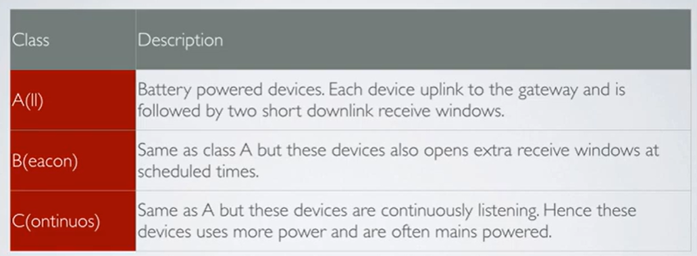
..
LoRaWAN: Device Classes
..

Slide 46
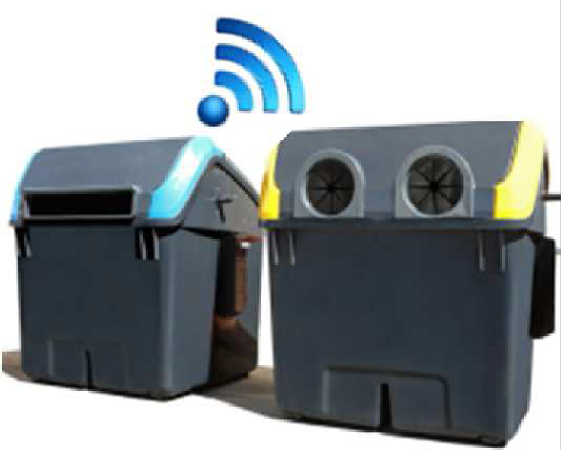
Class A
Bi-directional end-devices (Class A): End-devices of Class A allow for bi-directional communications whereby each end-device’s uplink transmission is followed by two short downlink receive windows.
This Class A operation is the lowest power end-device system for applications that only require downlink communication from the server shortly after the end-device has sent an uplink transmission.

Slide 47
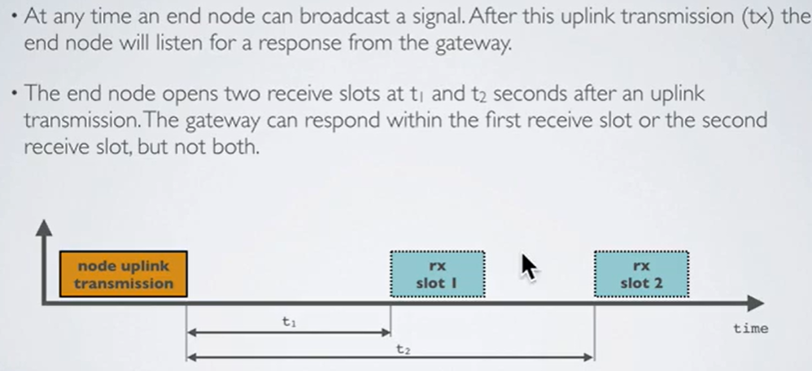
LoRaWAN Device Classes-Class A

Slide 48
LoRaWAN Device Classes- Class A
All LoRaWAN end-devices must support Class A implementation
Class A devices can send uplink messages at any time.
After an uplink, two short receive windows open for downlink messages.
RX1 Delay and RX2 Delay occur between the uplink and each receive window.
If no response is received in these windows, the next downlink is scheduled after the next uplink.
Class A devices have low power consumption, enabling battery operation.
They spend most time in sleep mode with long intervals between uplinks.
High downlink latency due to needing an uplink before receiving a downlink.

Slide 49
LoRaWAN Device Classes- Class A
Use Cases
Environmental monitoring
Animal tracking
Forest fire detection
Water leakage detection
Smart parking
Asset tracking
Waste management

Slide 50
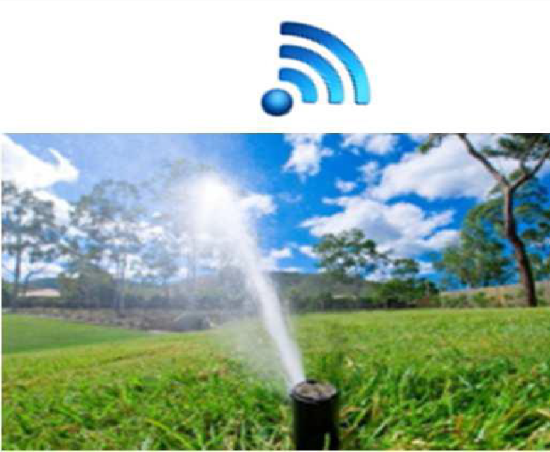
Class B
Bi-directional end-devices with scheduled receive slots (Class B): In addition to the Class A random receive windows, Class B devices open extra receive windows at scheduled times.
In order for the end-device to open its receive window at the scheduled time, it receives a time-synchronized beacon from the gateway. This allows the server to know when the end-device is listening.

Slide 51
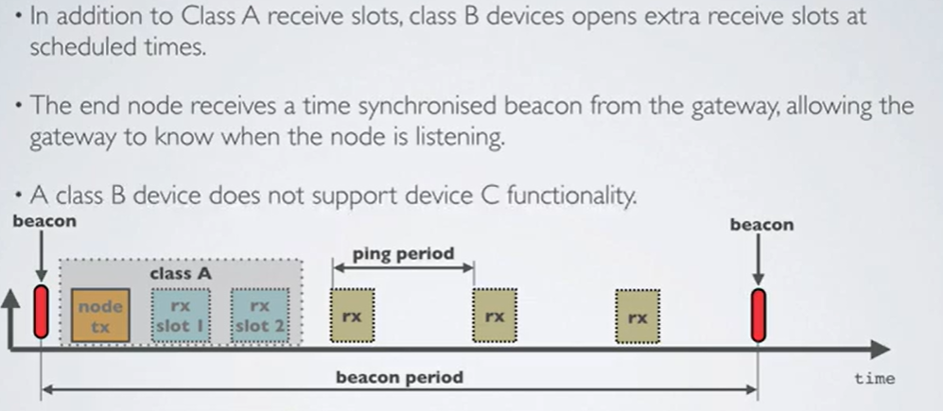
LoRaWAN Device Classes- Class B

Slide 52
LoRaWAN Device Classes-Class B
Class B Capabilities: Extends Class A by periodically opening receive windows (ping slots) for downlink messages.
Beacons: The network broadcasts time-synchronized beacons, allowing end devices to align their internal clocks for precise timing of downlinks.
Beacon Period: The time interval between two beacons.
Receive Windows: Similar to Class A, RX1 and RX2 open after an uplink.
Latency and Power Consumption:Lower downlink latency than Class A but higher than Class C.
Typically battery-powered; battery life is shorter than Class A due to beacons and ping slots.

Slide 53
LoRaWAN Device Classes- Class B
Use Cases: Suitable for devices needing medium-criticality downlink timing, such as:
Utility meters (e.g., electricity, water)
Street lights
Class A Compatibility: Can also operate in Class A mode if needed.

Slide 54
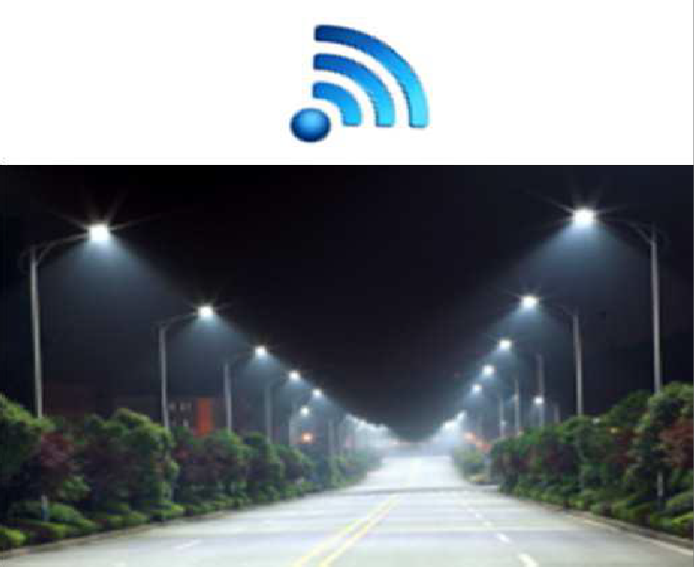
Class C
Bi-directional end-devices with maximal receive slots (Class C)
End-devices of Class C have almost continuously open receive windows, only closed when transmitting.

Slide 55
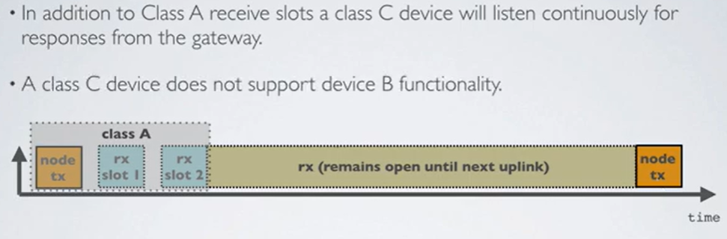
LoRaWAN Device Classes- Class C

Slide 56
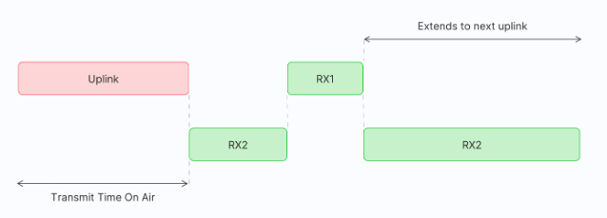
LoRaWAN Device Classes
Class C Capabilities: Extends Class A by keeping receive windows open, except during uplink transmissions.
Receive Windows: Opens RX1 and RX2 after uplink, similar to Class A. RX2 remains open continuously until the next uplink.
Low Latency: Can receive downlink messages at almost any time, providing very low latency.
Power Consumption: Higher power usage due to continuous receive windows; typically mains-powered rather than battery-powered.
Use Cases: Ideal for applications needing immediate actuation, such as:
Utility meters (electric, water)
Street and beacon lights
Alarms
Class A Compatibility: Can also switch to Class A mode when needed.
Class C

Slide 57
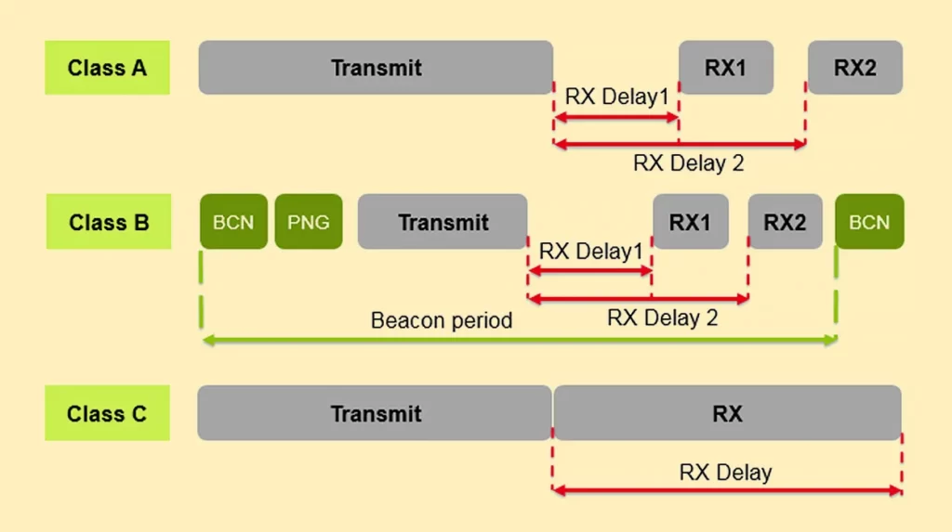
LoRaWAN Device Classes

Slide 58
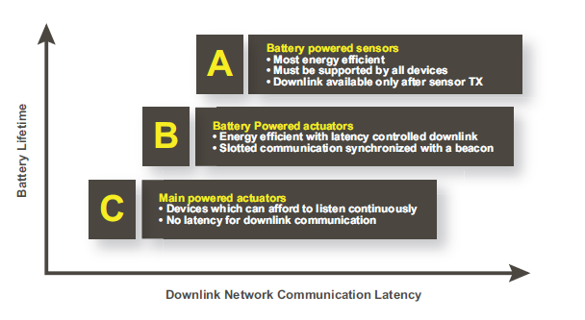

Slide 59
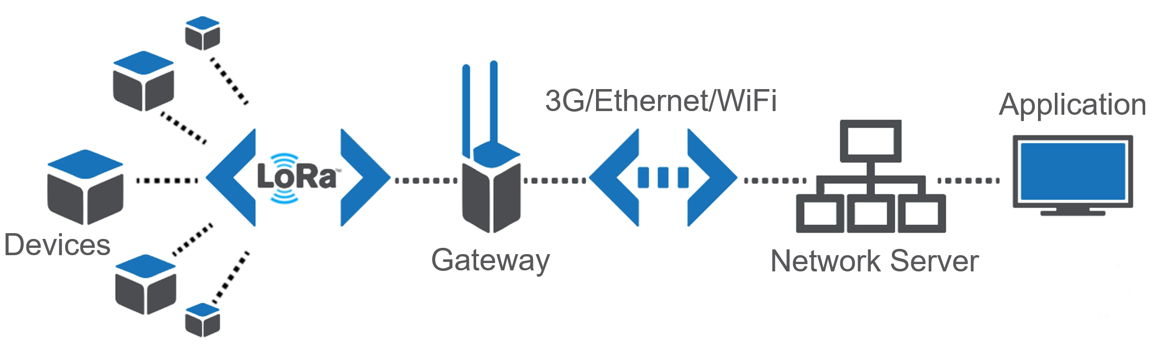
Network Architecture

Slide 60
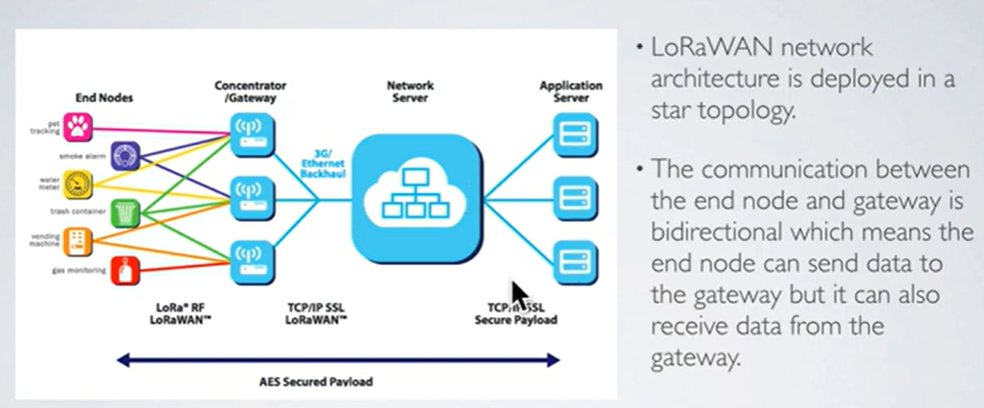
LoRaWAN Network Architecture

Slide 61
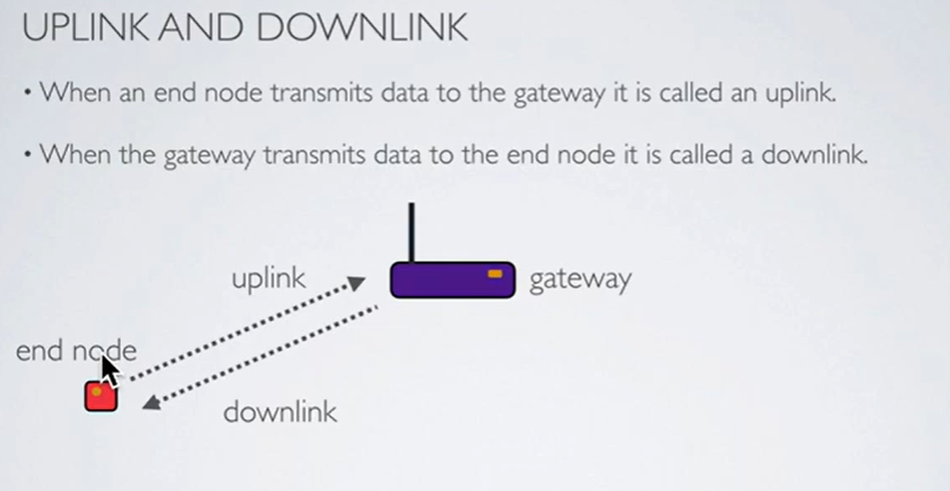
LoRaWAN Network Architecture

Slide 62
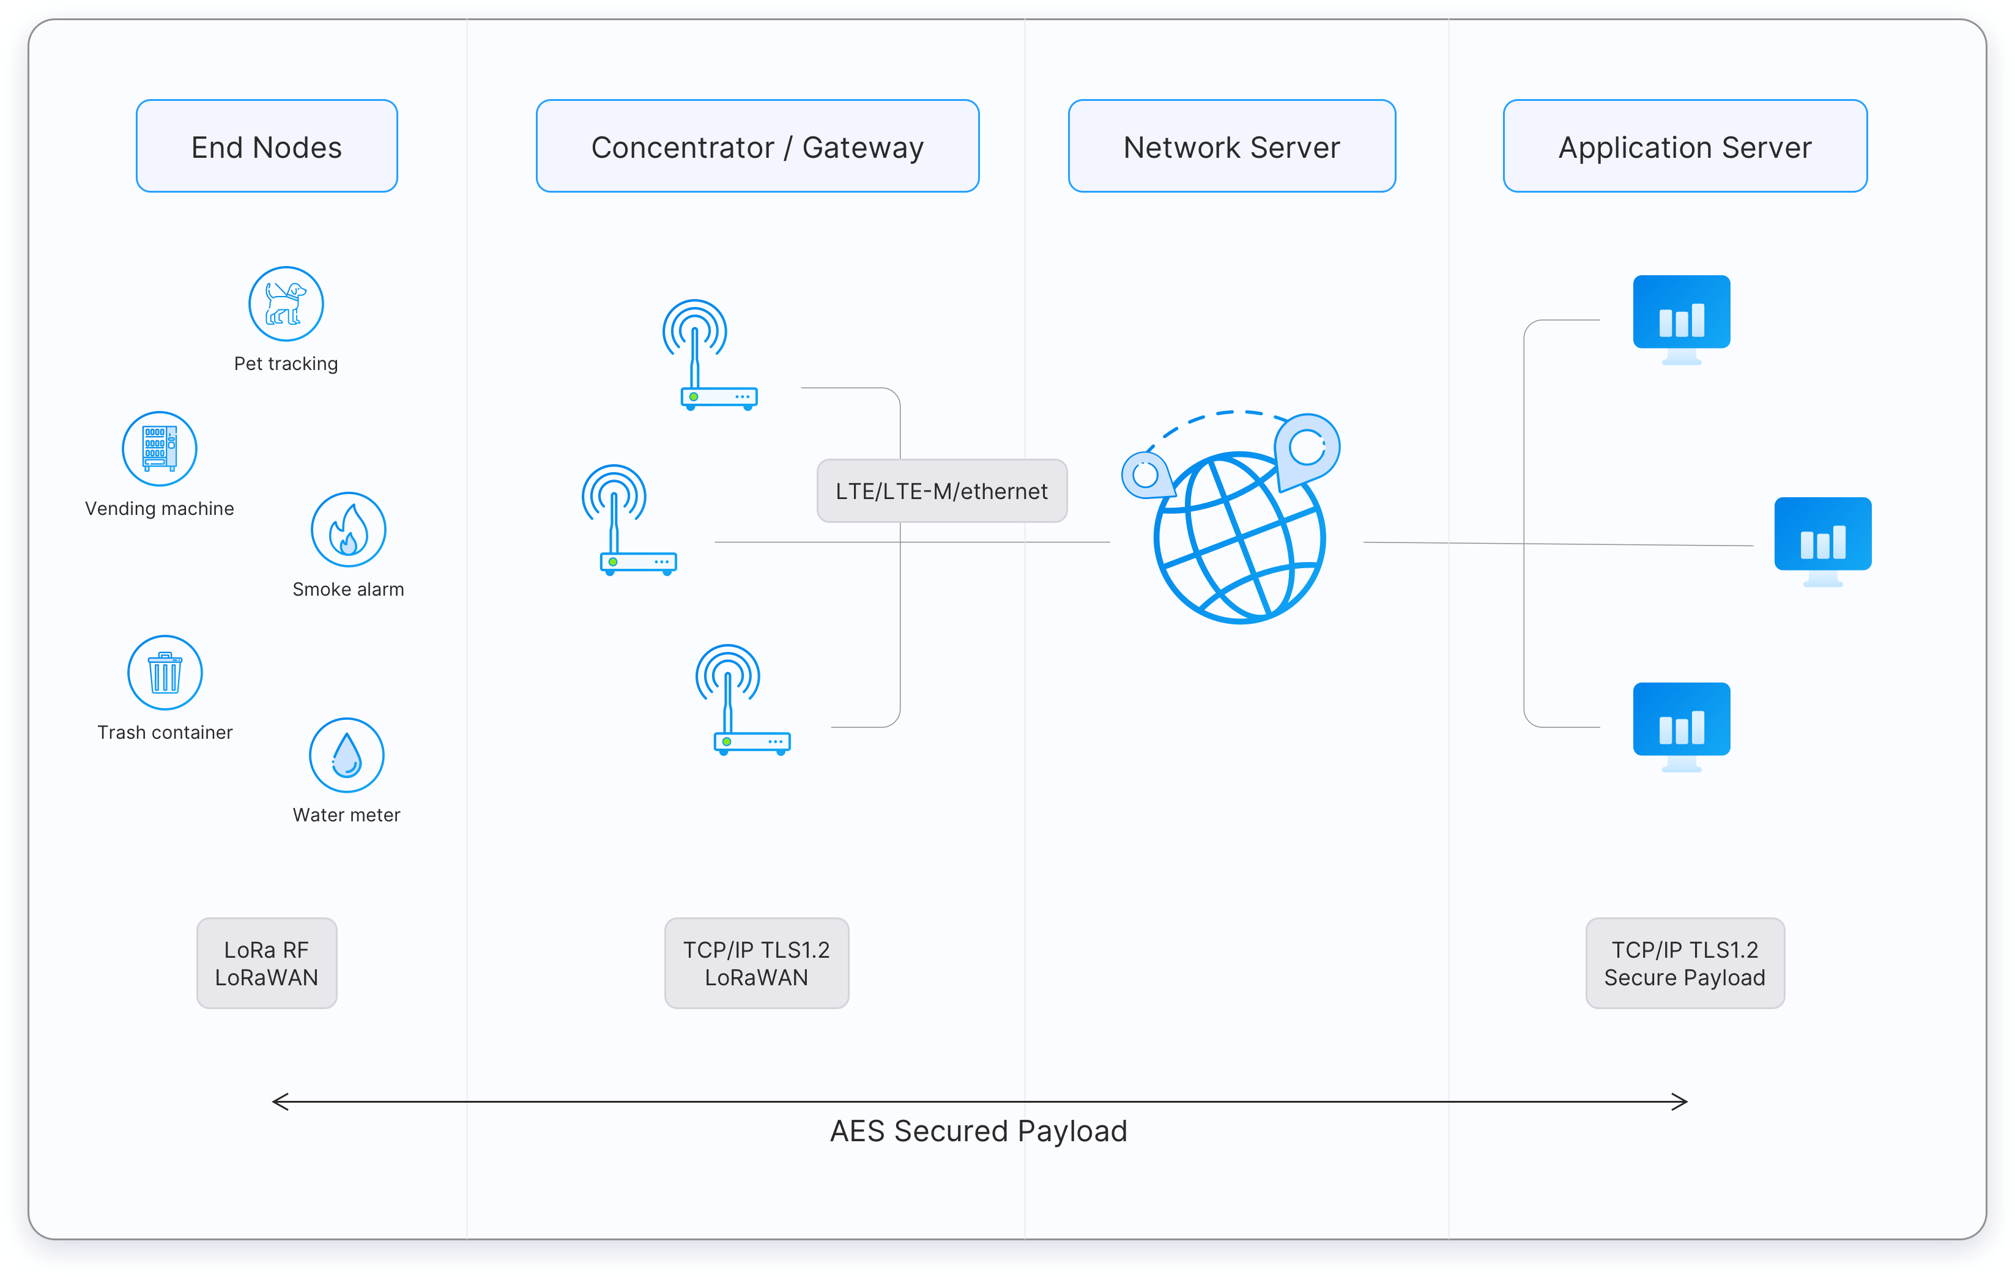
LoRaWAN Architecture

Slide 63
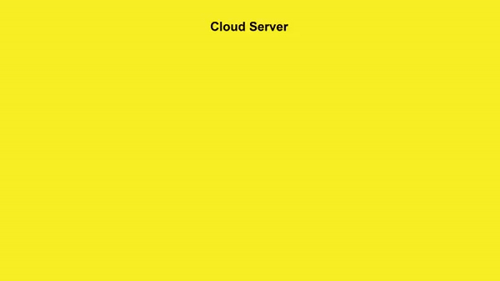
LoRaWAN Architecture
The LoRa Alliance® is an open, non-profit association established in 2015.
LoRaWAN is now an ITU standard
LoRaWAN networks are deployed in a star-of-stars topology.
End Devices - sensors or actuators send LoRa modulated wireless messages to the gateways or receive messages wirelessly back from the gateways. .
Gateways - receive messages from end devices and forward them to the Network Server.
Network Server - a piece of software running on a server that manages the entire network.
Application servers - a piece of software running on a server that is responsible for securely processing application data.

Slide 64
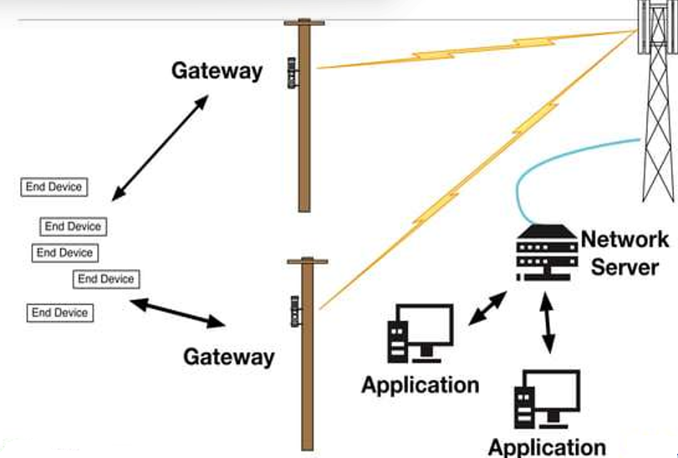
LoraWAN Entities

Slide 65
LoRaWAN: End Device
a LoRa client device, sometimes called a mote
Also sometimes called a node
Communicates with gateways
And never with other motes or nodes
Has a globally unique identifier called DevEUI
In the format of an IEEE EUl64 (64 bit)
Has a network unique identifier called DevAddr
Only network unique 32 bit

Slide 66
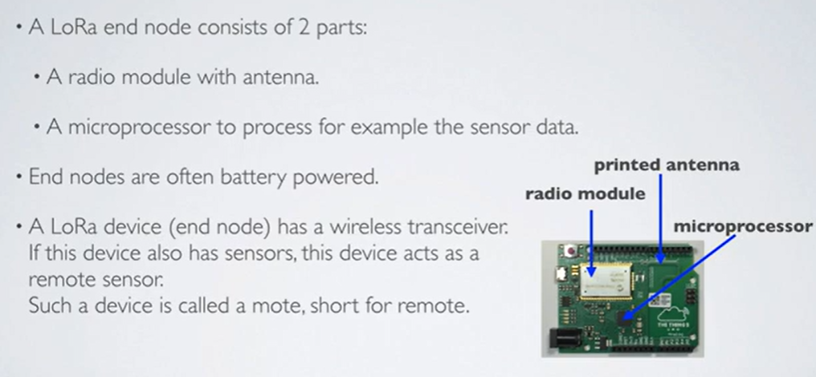
LoRaWAN: End Device

Slide 67
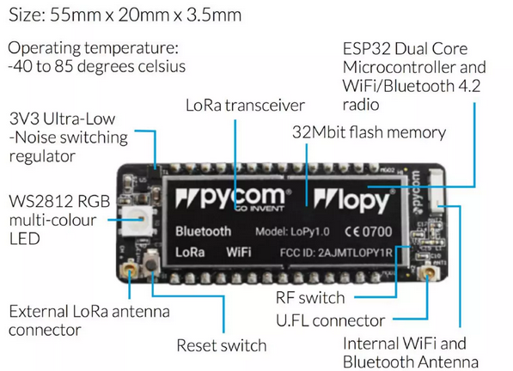
LoRaWAN: End Device

Slide 68
LoRaWAN: Gateway
A radio on the infrastructure side
Sometimes called a concentrator or /Jase-station
Communicates with end devices via LoRaWAN
Communicates with a network server via TCP/IP
Can co-exist on multi-protocol base stations
Typically runs a software instance per gateway radio

Slide 69
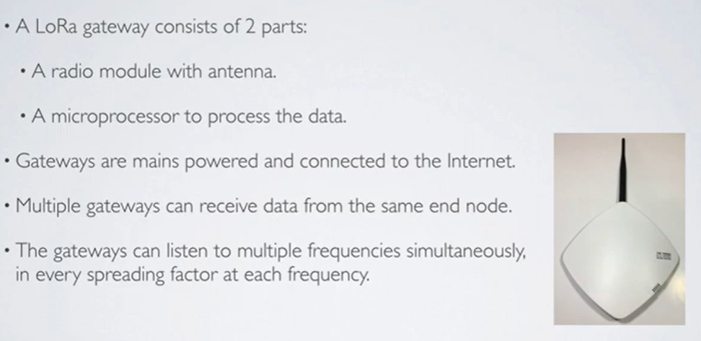
LoRaWAN: Gateway

Slide 70
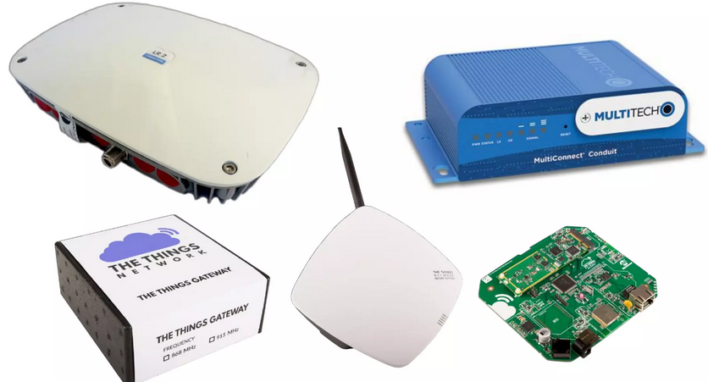
LoRaWAN: Gateway

Slide 71
LoRaWAN: Network Server (NS)
The Network Server terminates LoRaWAN MAC layer for End-Devices connected to the network
It is the centre of the star topology
The Network Server decides:
which Gateway will talk to which End Device
what data rates will be used by End Devices

Slide 72
LoRaWAN: Network Server (NS)
::ubidots
•••
THE THINGS
N E T W O R K
I
II I
'I
LOR I 0 T

Slide 73
LoRaWAN: Join Server (JS)
Server on the Internet Side of a Network Server
Processes join requests from end-devices
End devices cannot be used without joining a network
Often combined with the Network Server

Slide 74
LoRaWAN: Uplink Message
Communications from end devices to the network server or application
Received via one or more gateways
Uplink Messages received by more than one gateways are de-duplicated by the Network Server

Slide 75
LoRaWAN: Downlink Message
Communications from network server or application
via one gateway
to a single end-device
or a group of end devices
Network Server decides which gateway is in the best place to send a downlink message to a particular device.

Slide 76
LoRaWAN: Application
Application layer code running on the end device
Application code running "behind" the network server
Most end devices will run only one application
Identified by a registered IEEE EUl64 value (AppEUI)
"Applications" typically run on Network Servers
Provide for device management
Route data to external applications
Misleading name: Could be called application router

Slide 77
LoRaWAN End Device Activation
Activation Requirement: Every end device must be registered with a network before communication, known as activation.
Activation Methods:
Over-The-Air Activation (OTAA): Most secure and recommended method.Devices perform a join procedure, receiving a dynamic address and negotiating security keys.
Activation By Personalization (ABP): Device address and security keys are hardcoded.Less secure and limits switching between network providers without manual key changes.

Slide 78
LoRaWAN: Over the Air Join (OTAA)
End devices must have two symmetric keys
Network Session Key (NwkSKey)
Application Key (AppKey)
Different from the AppSKey
Unique to every End Device
Device sends DevEUI, AppEUI, and AppKey
Network sends data allowing Dev to derive AppSkey
and NwkSKey (then proceed as a pre-joined device)

Slide 79
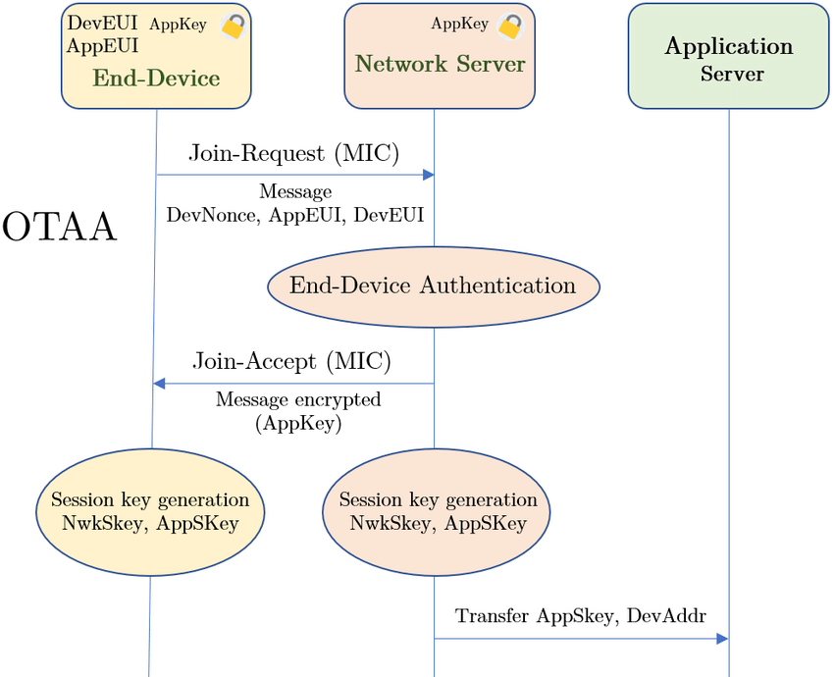
LoRaWAN End Device Activation-OTAA

Slide 80
LoRaWAN: OTA Join Process
LoRa Device sends JOIN_REOUEST (signed with AppKey). The join request contains the following Information: AppEUI. DevEUI, DevNonce.
DevNonce is a randomly generated number.
The Network Server receives tl1e JOIN_REOUEST and calculates AppSKey and NwkSKey based on: AppKey. AppNonce. NetID and DevNonce.
As with DevNonce, the AppNonce is another randomly generated number.
Network Server generates JOIN_ACCEPT and includes AppNonce
Device receives JOIN_ACCEPT (encrypted with AppKey). The JOIN_ACCEPT contains the following information: AppNonce. Net!D. DevAddr. RFU. RxDely. CFList
Now the Network Server and LoRa device have the same Information and the LoRa device can derive the NwkSkey and AppSKey

Slide 81
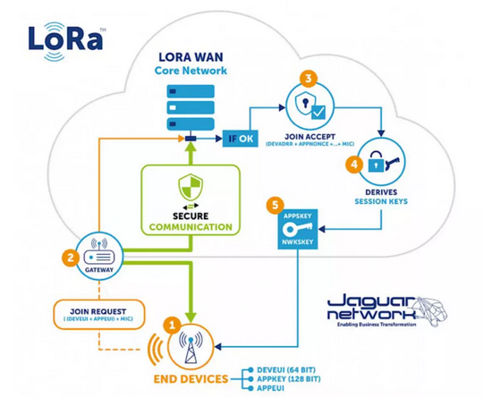
LoRaWAN: OTA Join Process

Slide 82
LoRaWAN: Pre-Joined Devices (ABP)
End devices must have two symmetric session keys
Devices are personalised with AES 128-bit keys
Network Session Key (NwkSKey)
Known only by the network operator
Protects network metadata
Application Session Key (AppSKey)
Common to all End Devices using an Application
Known only to the Application Operator

Slide 83

LoRaWAN End Device Activation

Slide 84
Security
It is extremely important for any LPWAN to incorporate security.
LoRaWAN™ utilizes two layers of security: one for the network and one for the application.
The network security ensures authenticity of the node in the network while the application layer of security ensures the network operator does not have access to the end user’s application data.
AES encryption is used.

Slide 85
Is LoRaWAN secure? How are the LoRaWAN protocol networks secured?
LoRaWAN Security

Slide 86
LoRaWAN: Encryption
All payloads are encrypted
No possibility for attackers to read payloads
No possibility for network operator to read payloads
and have data integrity
No possibility for changing data in flight
No possibility for intercepting & replaying data
MAC commands are protected (except frame options)
No possibility for attackers to read metadata

Slide 87

General Wireless Security

Slide 88
Confidentiality
Confidentiality is probably the most common aspect of information security. We need to protect our confidential information. An organization needs to guard against those malicious actions that endanger the confidentiality of its information.

Slide 89
Integrity
Information needs to be changed constantly. Integrity means that changes need to be done only by authorized entities and through authorized mechanisms.

Slide 90
Availability
The information created and stored by an organization needs to be available to authorized entities. Information needs to be constantly changed, which means it must be accessible to authorized entities.

Slide 91

Taxonomy of attacks with relation to security goals
1.91
Notes:
1.#

Slide 92
Attacks Threatening Confidentiality
Snooping refers to unauthorized access to or interception of data.
Traffic analysis refers to obtaining some other type of information by monitoring online traffic.
Notes:
1.#

Slide 93
Attacks Threatening Integrity
Modification means that the attacker intercepts the message and changes it.
Masquerading or spoofing happens when the attacker impersonates somebody else.
Replaying means the attacker obtains a copy of a message sent by a user and later tries to replay it.
Repudiation means that sender of the message might later deny that she has sent the message; the receiver of the message might later deny that he has received the message.
Notes:
1.#

Slide 94
Attacks Threatening Availability
Denial of service (DoS) is a very common attack. It may slow down or totally interrupt the service of a system.
Notes:
1.#

Slide 95

Security Attack Classification

Slide 96





Symmetric Key Cryptography
How to send this Key?
Ref Book:Cryptography and Network Security by Forouzan

Slide 97
Secret Key Cryptography
Also called symmetric or single‐key algorithms.
The encryption and the decryption key are the same.
Techniques based on a combination of substitution and permutation.
Stream ciphers: operate on single bit or byte.
Block ciphers: operate on blocks (typically 64/128/256… bits)
Advantage: simple, fast.
Disadvantage: key exchange, key management.
Examples: DES,RC4, IDEA, Blowfish, AES, etc.

Slide 98
Message Integrity
The cryptography systems that we have studied so far provide secrecy, or confidentiality, but not integrity.
However, there are occasions where we may not even need secrecy but instead must have integrity.
For example, Alice may write a will to distribute her estate upon her death.
The will does not need to be encrypted.
After her death, anyone can examine the will.
The integrity of the will, however, needs to be preserved.
Alice does not want the contents of the will to be changed.

Slide 99

Message and digest

Slide 100


Mutual End Point Authentication

Slide 101

Mutual End Point Authentication

Slide 102

Session Key Generation and Delivery

Slide 103

Data Origin Authentication, Integrity and Replay Protection

Slide 104

Payload Encryption +Data Origin Authentication, Integrity/Replay Protection

Slide 105

LoRa WAN End-to-End (Transport) Security

Slide 106

LoRa WAN End-to-End (Transport) Security

Slide 107

Overall/ Complete Security

Slide 108

OTAA Vs ABP

Slide 109

LoRaWAN Security
Security Keys : NwkSKey, AppSKey and AppKey
When a device joins the network (this is called a join or activation), an application session key AppSKey and a network session key NwkSKey are generated. The NwkSKey is shared with the network, while the AppSKey is kept private. These session keys will be used for the duration of the session.
The AppSKey is used for encryption and decryption of the payload.
The application key (AppKey) is only known by the device and by the application.

Slide 110



Hardware

Slide 111

Dashboard

Slide 112

LoRaWAN Ecosystem : Modules

Slide 113

LoRaWAN Ecosystem : Things

Slide 114

LoRaWA N Ecosystem : Gateways

Slide 115
LoRaWAN: Network Servers
Actility: https://www.actility.com/
Cable Labs: https://www.loraserver.io/
EveryNet: http://everynet.com/
Loriot: https://loriot.io/
ResloT: https://www.resiot.io/en/
The Things Network: https:// www.thethingsnetwork.org/

Slide 116

LoRaWAN: Application Platforms

Slide 117
LoRaWAN: Selected Platforms
Actility ThingPark
Amazon AWS loT
EveryNet
IBM BlueMix
Microsoft Azure loT
MyDevices Cayenne
OpenChirp
Stream loTx

Slide 118
LoRaWAN Limitations
Not suitable for:
Real-time data: Limited to small, infrequent packets.
Phone calls: Use GPRS/3G/LTE instead.
Home automation: Use ZigBee or Bluetooth.
High-data tasks: For photos or video, use WiFi.
Uplink Efficiency Tips:
Payload: Minimize size; use binary format (e.g., Cayenne LPP).
Message Interval: Send at several-minute intervals or upon significant changes.
Data Rate: Start with SF7BW125 for low power and airtime; enable Adaptive Data Rate (ADR) if needed.
Downlink Efficiency Tips:
Minimize Downlinks: Avoid if possible, use small payloads.
Data Rate: Downlink rate depends on uplink efficiency.
Avoid Confirmations: Use unconfirmed uplinks if possible to reduce network load and boost reliability.

Slide 119
What is a Smart City?
It’s a city outfitted with high-tech communication capabilities.
It uses digital technology to enhance performance and well being, to reduce costs and resource consumption, and to engage more effectively and actively with its citizens.
Prime Minister Narendra Modi’s vision ‘Digital India’, has a plan to build 100 smart cities across the country.
Modi in his speech said, “Cities in the past were built on riverbanks. They are now built along highways. But in the future, they will be built based on availability of optical fiber networks and next-generation infrastructure.”

Slide 120



Slide 121

Why smart city ???

Slide 122



IoT and Smart Cities
Smart cities aim to improve quality of life, sustainability, and efficiency, addressing urban challenges like congestion, pollution, and resource management.
IoT (Internet of Things): Connects devices across urban environments, collecting real-time data for monitoring and control.’
LoRaWAN (Long Range Wide Area Network): Provides low-power, long-distance communication ideal for large-scale IoT networks in cities.
GIS (Geographical Information Systems): Visualizes spatial data, enabling urban planners to make data-driven decisions.
GPS (Global Positioning System): Supports tracking of assets and optimizing public services like transportation.

Slide 123


LoRaWAN Usecase
Image source : Semtech

Slide 124
Jamshedpur – A Smart City
Successful Initiatives
Smart Bins
Smart Parking
Smart Lighting
Smart Manholes
Water Tank Level Detector
Smart Pond Management System
Intrusion Detectors
Smart Transformer Monitoring System

Slide 125

Smart Bins
Smart bins have been installed in Jamshedpur which senses if the dustbin is filled up or not and sends the data through Lora.

Slide 126

Smart Bins with Sensors installed in Jamshedpur

Slide 127

Smart Parking
Parking Sensors senses if there is a vehicles present in the parking spot or not and thereby, sends an appropriate signal through Lora.
This data is used to know where parking spaces are empty and thus help the traffic in parking their vehicles.

Slide 128

Parking Sensors placed in Jamshedpur

Slide 129

Smart Lighting
Street Lights integrated with Lora modules are put across streets in Jamshedpur which help in controlling their working from one control station.
This helps in saving a lot of power as the street lights are switched on and switched off in time and lights are dimmed at nights .

Slide 130


A Street light in Jamshedpur .

Slide 131

Smart Manholes
Manholes are fitted with sensors which help them know the level of water in the manhole and thus help in controlling overflow.

Slide 132


Manholes installed with sensors fitted with lora modules in Jamshedpur.

Slide 133

Water Tank Level Detector
Water Tank Level Detectors are installed across water tanks in Jamshedpur which help in knowing the real time water level in tanks in the control room

Slide 134


Water tank level sensor installed in Kadma, jamshedpur.

Slide 135

Smart Pond Management System
Smart Pond Management Sensors are put in different ponds to help in knowing the DO, amount of chlorine in the water at any given time to help the aquatic life flourish.

Slide 136

Intrusion Detectors
Intrusion Detectors are installed in places where high security is needed like the water tank distribution area.

Slide 137
Smart Transformer Monitoring System
Lora modules help the sensors put inside the transformers to send the temperature readings and thereby, help in monitoring the condition of the transformer and ensure timely repairs.

Slide 138

Integration of LoRaWAN and Geospatial Technologies
Real-Time Data Collection with LoRaWAN Sensors
Key Benefits:
Wide Coverage: Ideal for urban environments, covering large areas with fewer gateways.
Low Power Consumption: Extends the battery life of sensors, making them suitable for continuous monitoring.
Real-Time Data: Provides timely data on various urban metrics, such as:
Air quality levels
Noise pollution
Traffic flow
Waste management metrics
Scalability: Easily integrates additional sensors as urban needs grow

Slide 139

Integration of LoRaWAN and Geospatial Technologies
Geospatial Platforms (GIS)
Role of GIS in Urban Management: Geographic Information Systems (GIS) facilitate the analysis, visualization, and management of spatial data.
Visualization of Data:
Map-Based Interfaces: Present data collected from LoRaWAN sensors in an easily interpretable format.
Layered Data Analysis: Users can overlay multiple datasets (e.g., traffic, air quality) to identify patterns and correlations.
Enhanced Decision-Making:
Informed Urban Planning: Leverages real-time data to make proactive decisions regarding infrastructure and services.
Responsive Policy Formulation: Data-driven insights enable local governments to address urban challenges effectively.
Image source : Geospatial World

Slide 140

The Things Industries is a full-service LoRaWAN solutions provider
Build, grow and scale with The Things Stack Cloud
Image source : the things network

Slide 141

Thank You!!!

